Slide 1

React Made Easy: A Beginner’s Guide to Effortless Web Development
Presented by Alexandru Constantin

Slide 2
First, ensure that NodeJS is installed correct version (v22.5.1)
Run the node -v command
And the winget update –id OpenJS.NodeJS command to update your package

Slide 3
What is ReactJS?

Slide 4


ReactJS is a JavaScript library for building user interfaces, developed and maintained by Facebook.

Slide 5
Features
Component-Based Architecture
Virtual DOM
Unidirectional Data Flow
Component Control
Hooks
What makes React so useful?

Slide 6
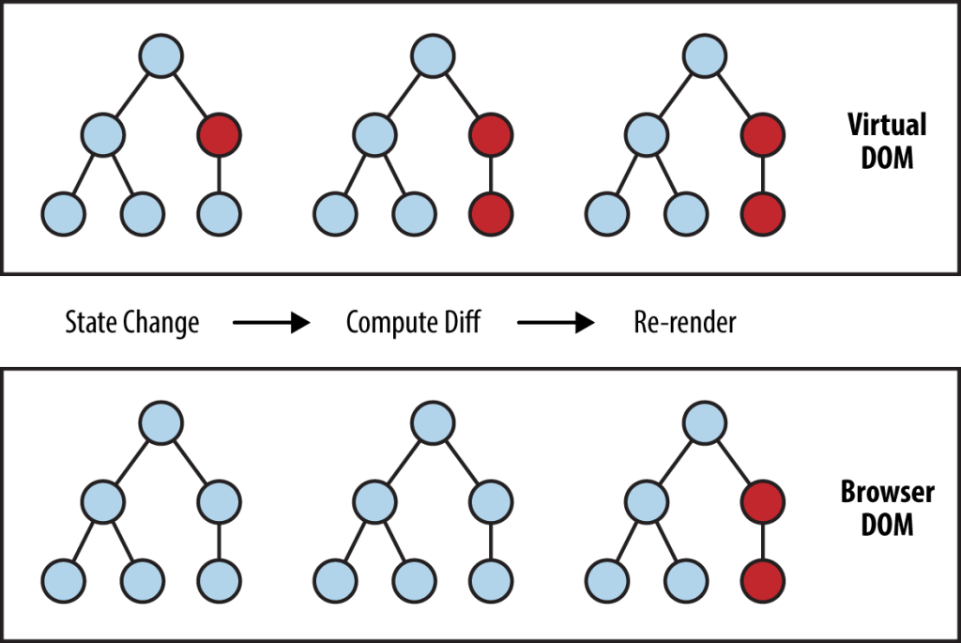
Virtual DOM (Document Object Model) Visualisation

Slide 7
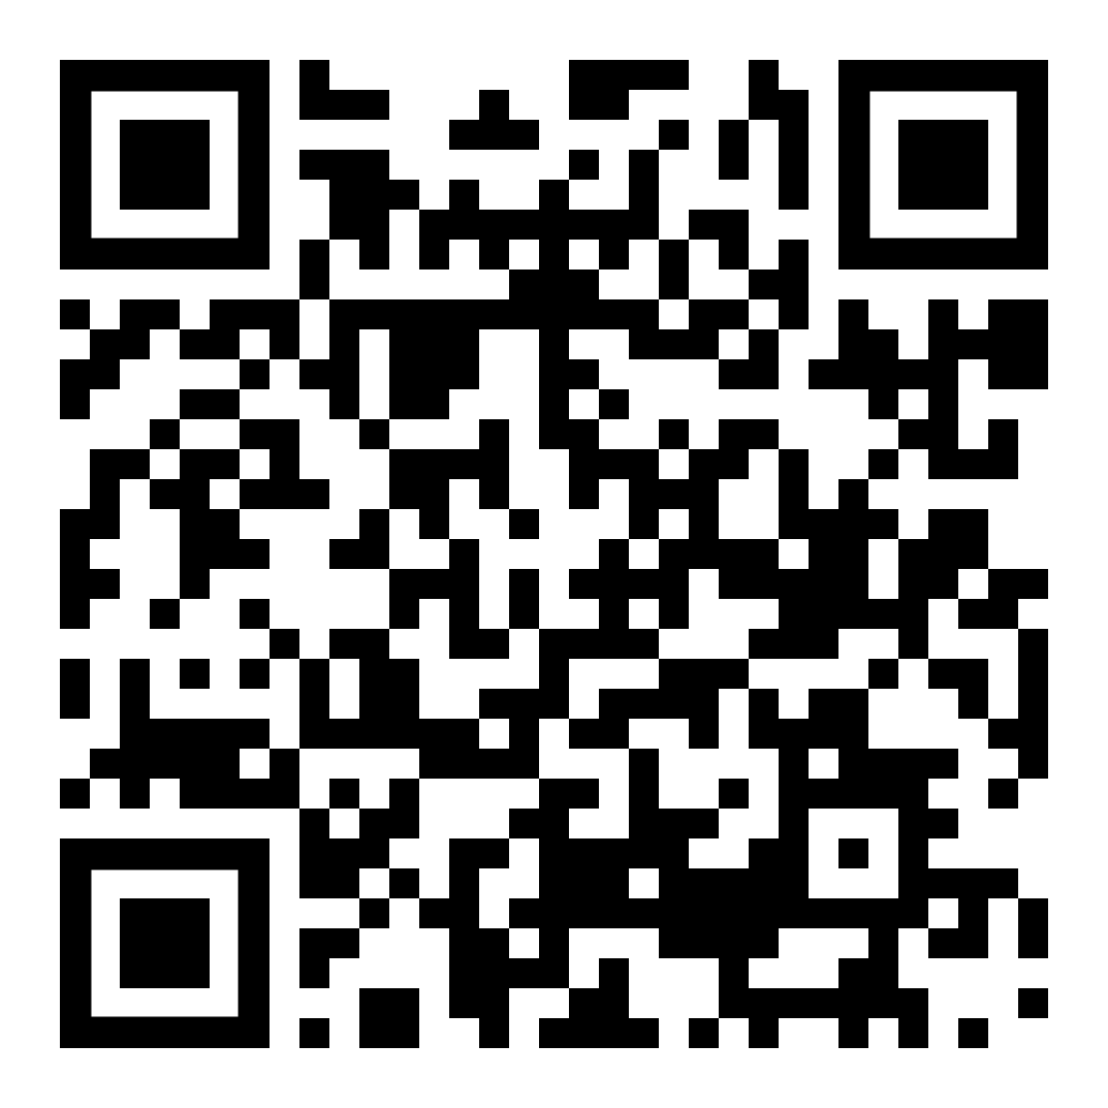
Before we continue, let’s fork the first project
https://github.com/Constantin-Alexandru/weather-display

Slide 8
React Components

Slide 9
What are React Components?
Reusable
Self-contained
The building blocks of a React application.

Slide 10
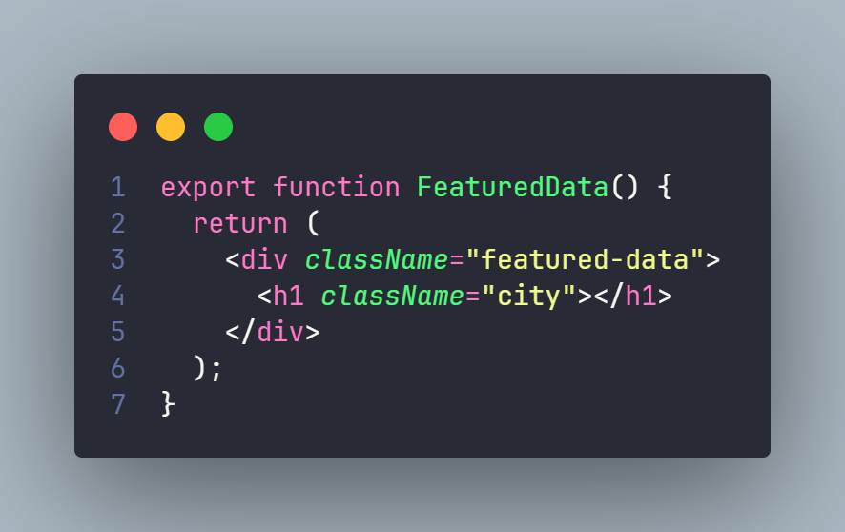
Defining a React component

Slide 11
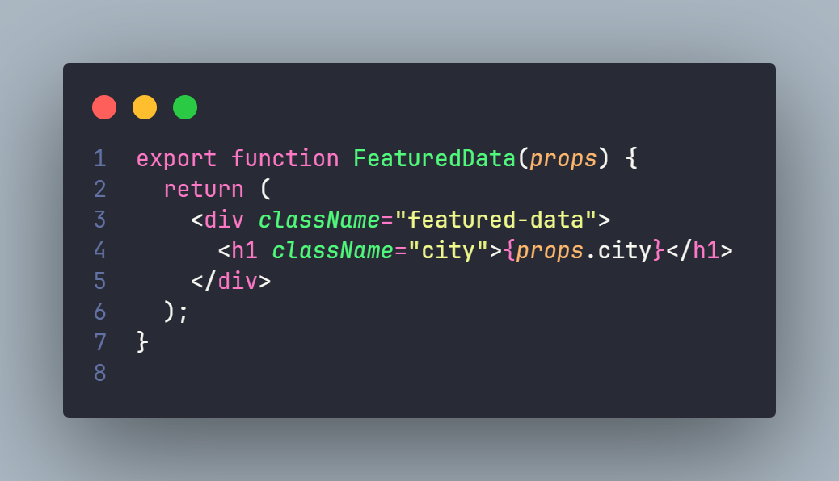
React props
And how to use them

Slide 12
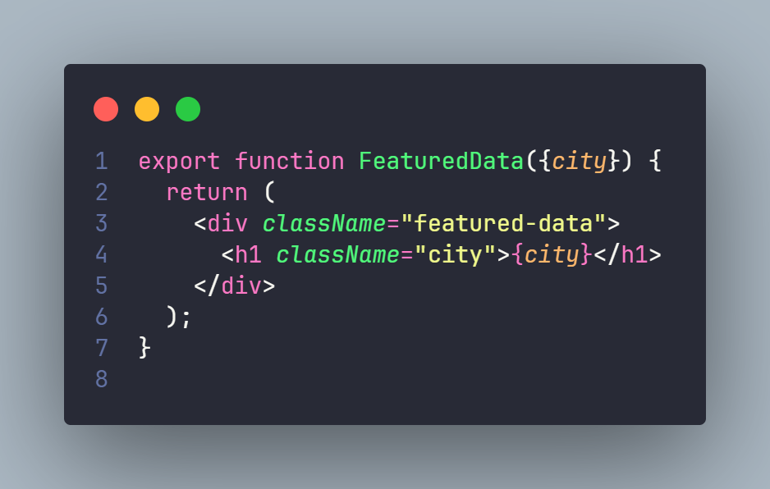
React props
And how to use them

Slide 13
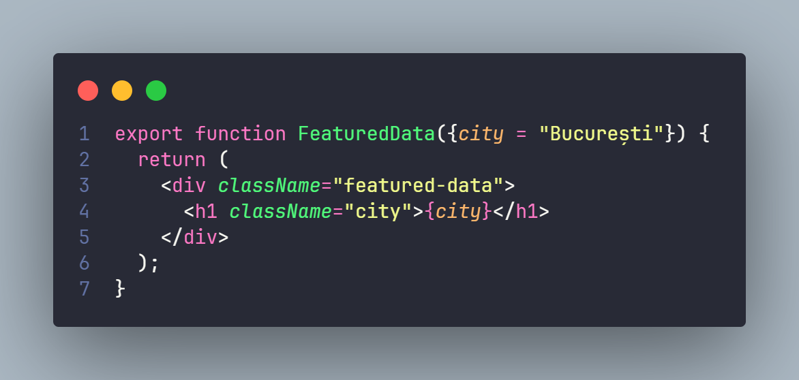
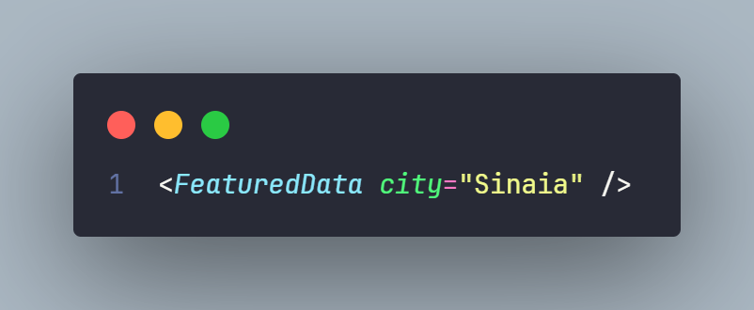
Passing Props
From parent to child

Slide 14
Your turn now,
add the correct data to the components & create a component to display one hour’s forecast.

Slide 15
React Hooks

Slide 16
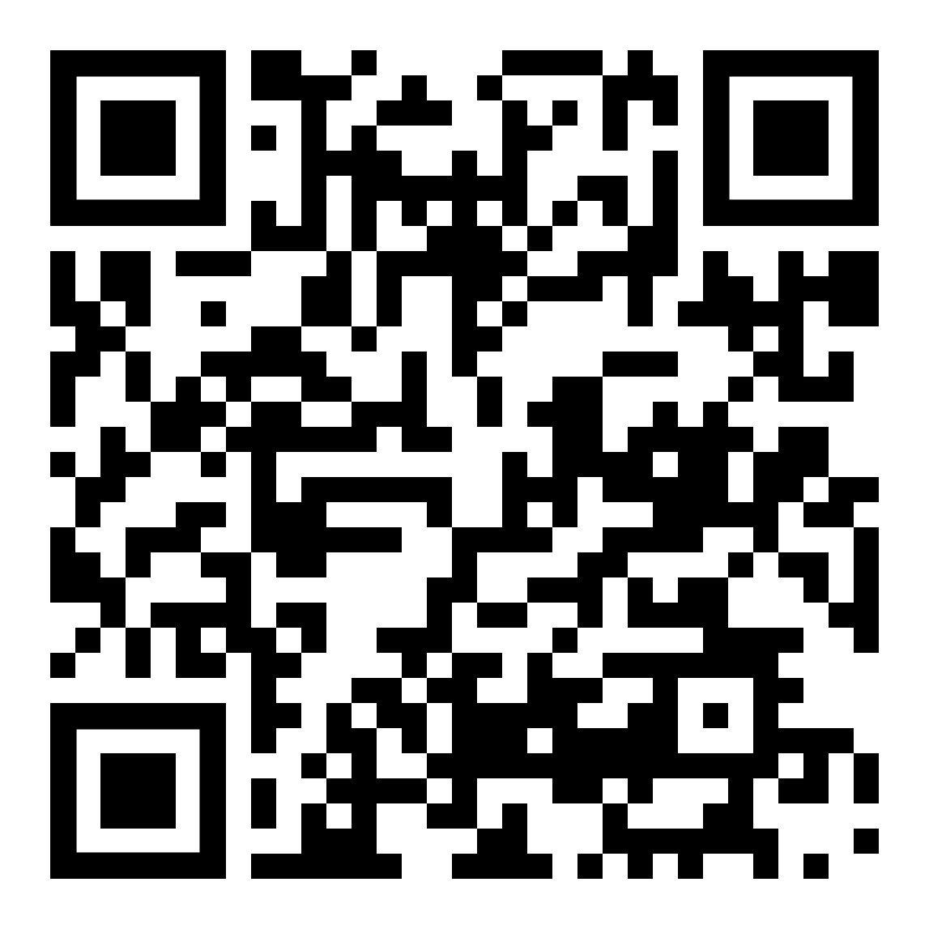
Let’s fork the second project
https://github.com/Constantin-Alexandru/tic-tac-toe

Slide 17
What are hooks?
Hooks are functions that let you use state and other React features in functional components.
And why are they useful?

Slide 18
Why are they useful?
Simplified Code
Reusability
Improved Performance

Slide 19
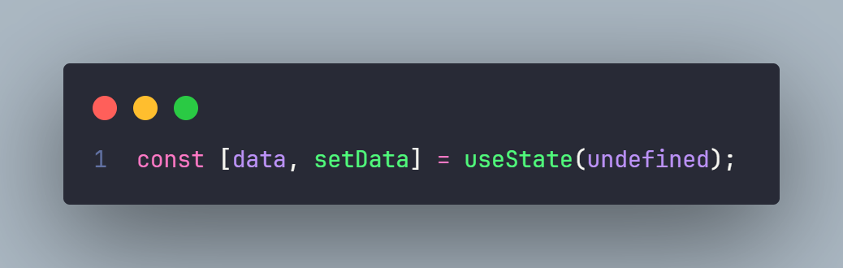
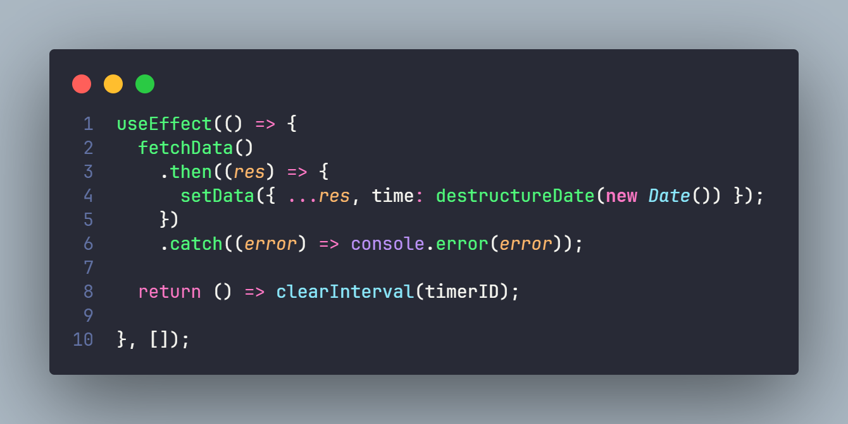
React Hooks
There are more:
https://react.dev/reference/react/hooks

Slide 20
What dynamic data will you have in the Tic Tac Toe?
Who’s turn it is?
The state of the board?
Is the game over?
Who won then?

Slide 21
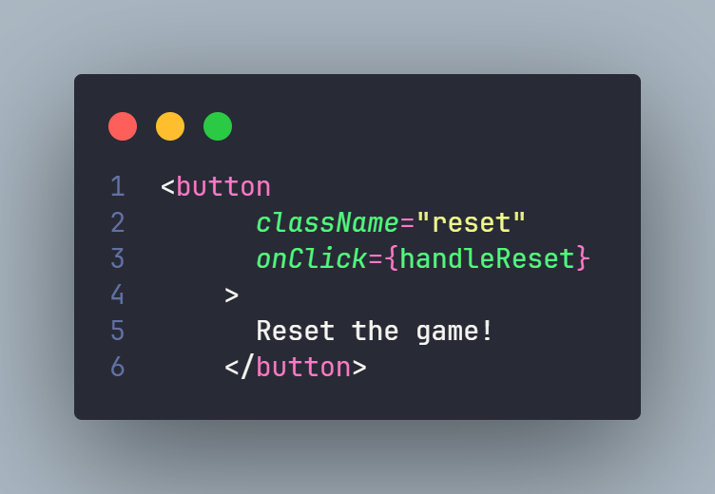
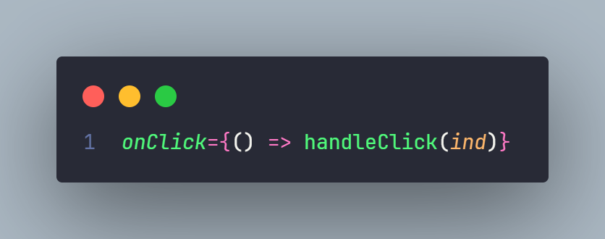
How to change data onclick

Slide 22
Your turn now,
try and implement the game.

Slide 23
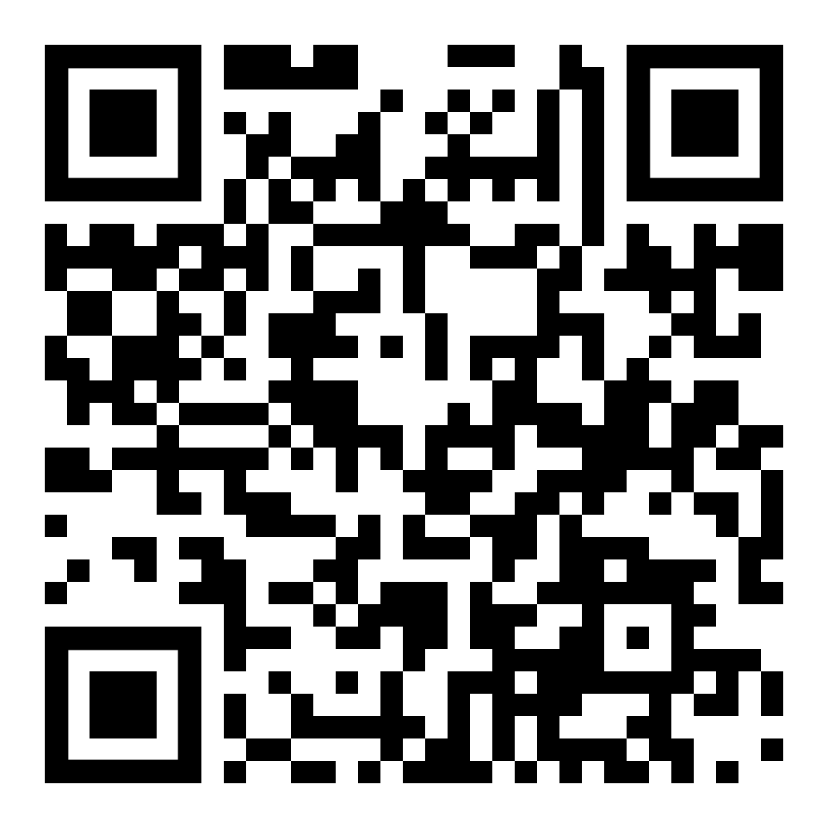
The finalised version is available here
https://github.com/Constantin-Alexandru/Noughts-And-Crosses/

Slide 24
Thank you for listening to me!
2024 Copyright © by INPROTED - International Professionals for Technology and Education. All rights reserved

